Slide 1

Reduced Tackle Height Laws 2026
Svenska Rugbyförbundet player welfare (assisted with research from the Scottish Rugby Union)

Slide 2
Why are we changing the tackle height?
Following on from consultation with community rugby stakeholders, SRFs Player Welfare Committee approved a lower maximum tackle height law trial of below the sternum for implementation across community game, beginning in the 2026 season.
This change has been led by World Rugby endorsed research which has proven there to be positive outcomes on the reduction of tackle height on the reduction of head-to-head contact in game.

Slide 3
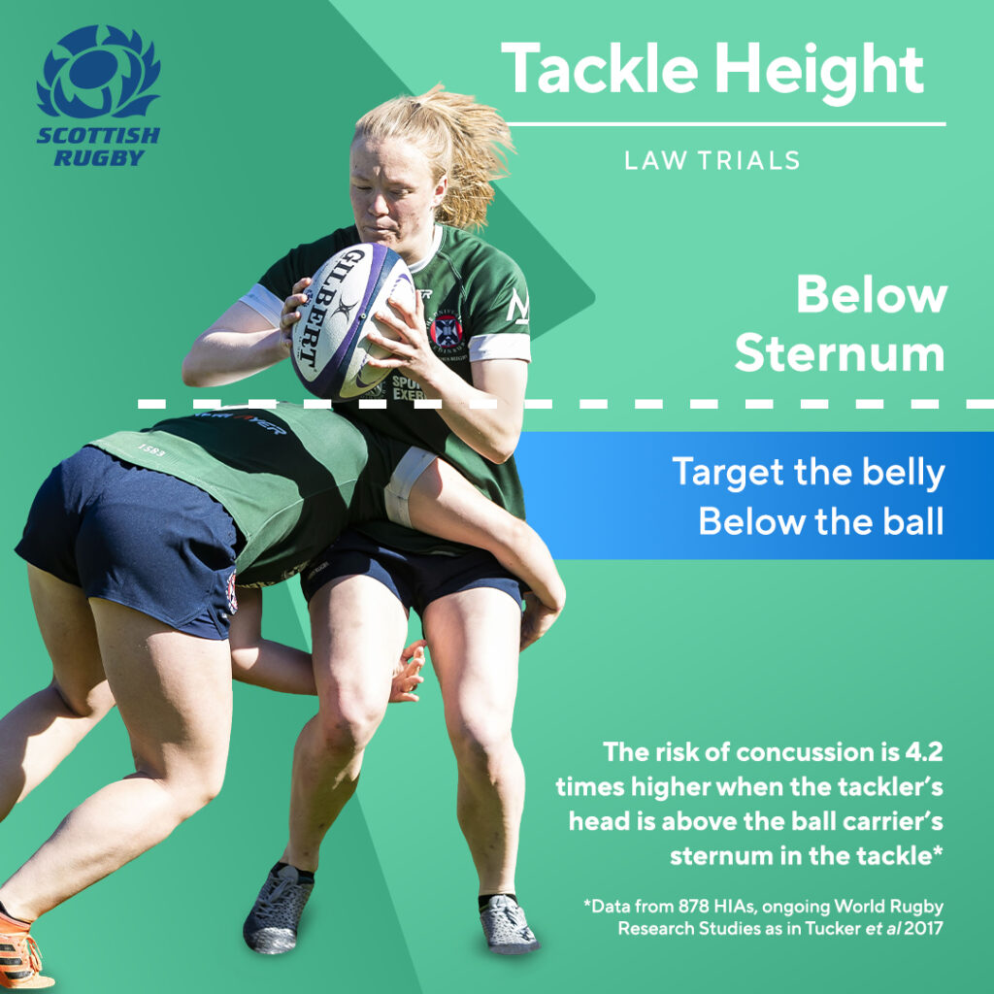
What does this tackle height look like?

Slide 4

What does the tackle height look like?
The below video shows examples of the maximum tackle height.

Slide 5
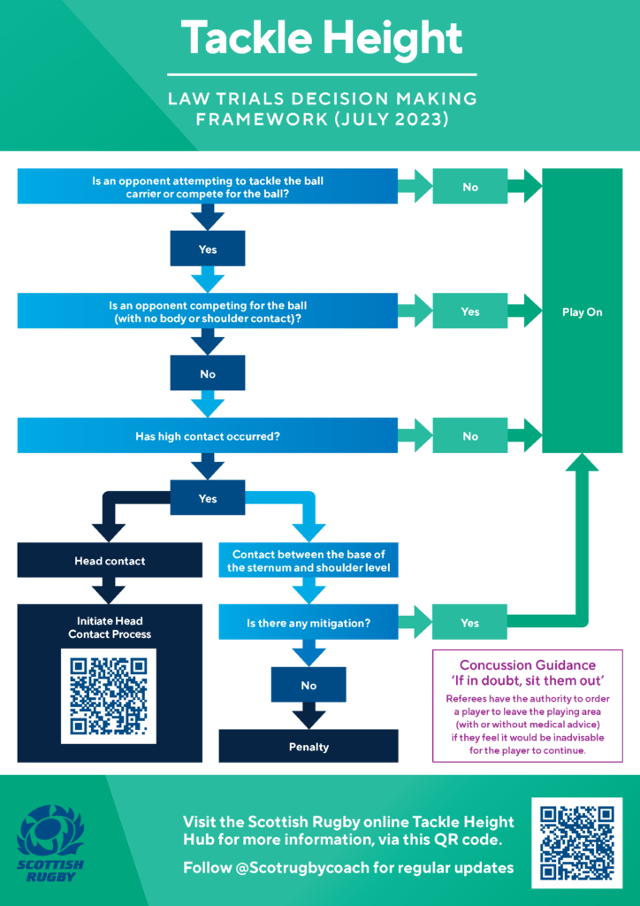
Decision Making Framework

Slide 6
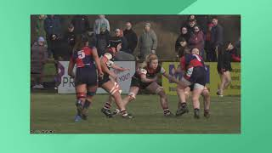
Decision making framework
The below video walks you through the decision making framework

Slide 7
Who will this change affect
The law change will apply to:
All levels of the male and female, adult and youth community rugby, up to and including the men’s and women’s Allsvenskan
All alternative formats including 7s and 10s

Slide 8
What does the research say about reducing the tackle height?
In World Rugby endorsed trials conducted in France and South Africa, lowering the tackle height has been shown to reduce the number of head-on-head contacts and concussions. Lowering the tackle height has also shown positive outcomes regarding increased ball-in-play time and offloading.
Trials in France resulted in a 64% reduction in head-on-head contacts and a 23% reduction on concussions.
Research shows that by lowering the tackle height there will be a significant reduction in concussions.

Slide 9
What does the research say about the tackle height ABOVE the sternum?
74% of all concussions come from the tackle area.
Approx. 70% of concussions at the tackle area relate to the tackler.
A tackle above the sternum is 4.3 times more likely to result in a head injury.

Slide 10
Tackle Height Examples
To view examples of tackles that will and will not be permitted in season 2026, please click HERE.

Slide 11
Decision Making Framework for Referees
Tackle Height Decision Making Framework

